Slide 1
French Revolution & Napoleon's Reign
1789-1815

Slide 2
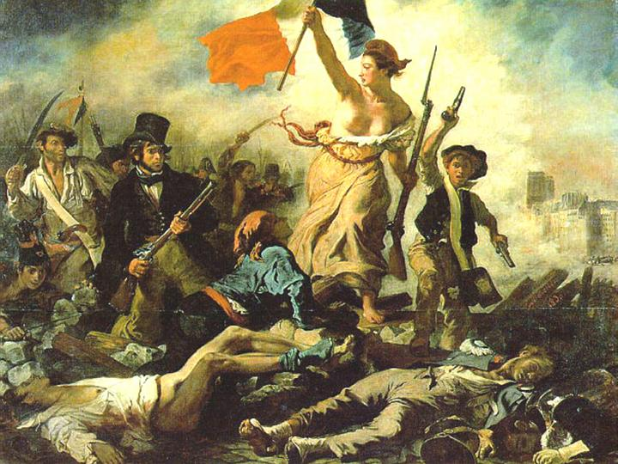
Questions
What were the causes for the French revolt?
Why was it so difficult for a stable government to function in France?
What were the benefits and the drawbacks to a dictatorship in France?

Slide 3
Background
In 1789, France still used an ancien regime
Divided social classes (called estates)
First Estate
Clergy
Second Estate
Nobility
Third Estate
Everybody else (mostly poor)

Slide 4
The estates

Slide 5
Society Divided
The clergy were members of the church and had the most wealth and did not pay taxes
Many criticized the church and wanted reform
Nobles held the top government jobs
Did not pay taxes, but also did not make as much money as the clergy
Third Estate had its own tier of classes
Bourgeoisie was at the top
Merchants, lawyers, business owners
The rest of the third estate was peasants and workers

Slide 6
Financial Troubles
France was in debt because of King Louis XIV
Too much money spent on the Seven Years War and the American Revolution
Bad harvests from crops also affected the economy
Many people were starving
Louis XV and XVI ran up the debt even more
King Louis XIV summoned the Estates-General to get a cahiers
Estates-General were representatives of each estate
Cahiers were a list of grievances against the king
Only property owners could vote, leading to misrepresentation

Slide 7
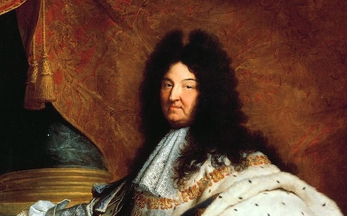
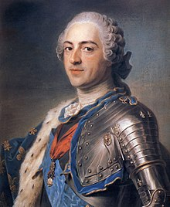
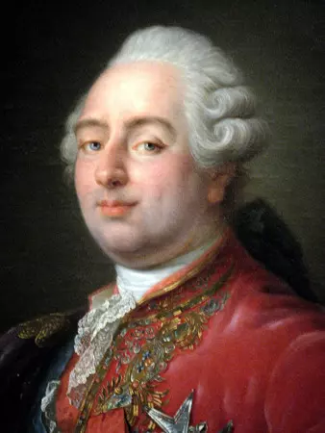
The Louis Family

Slide 8
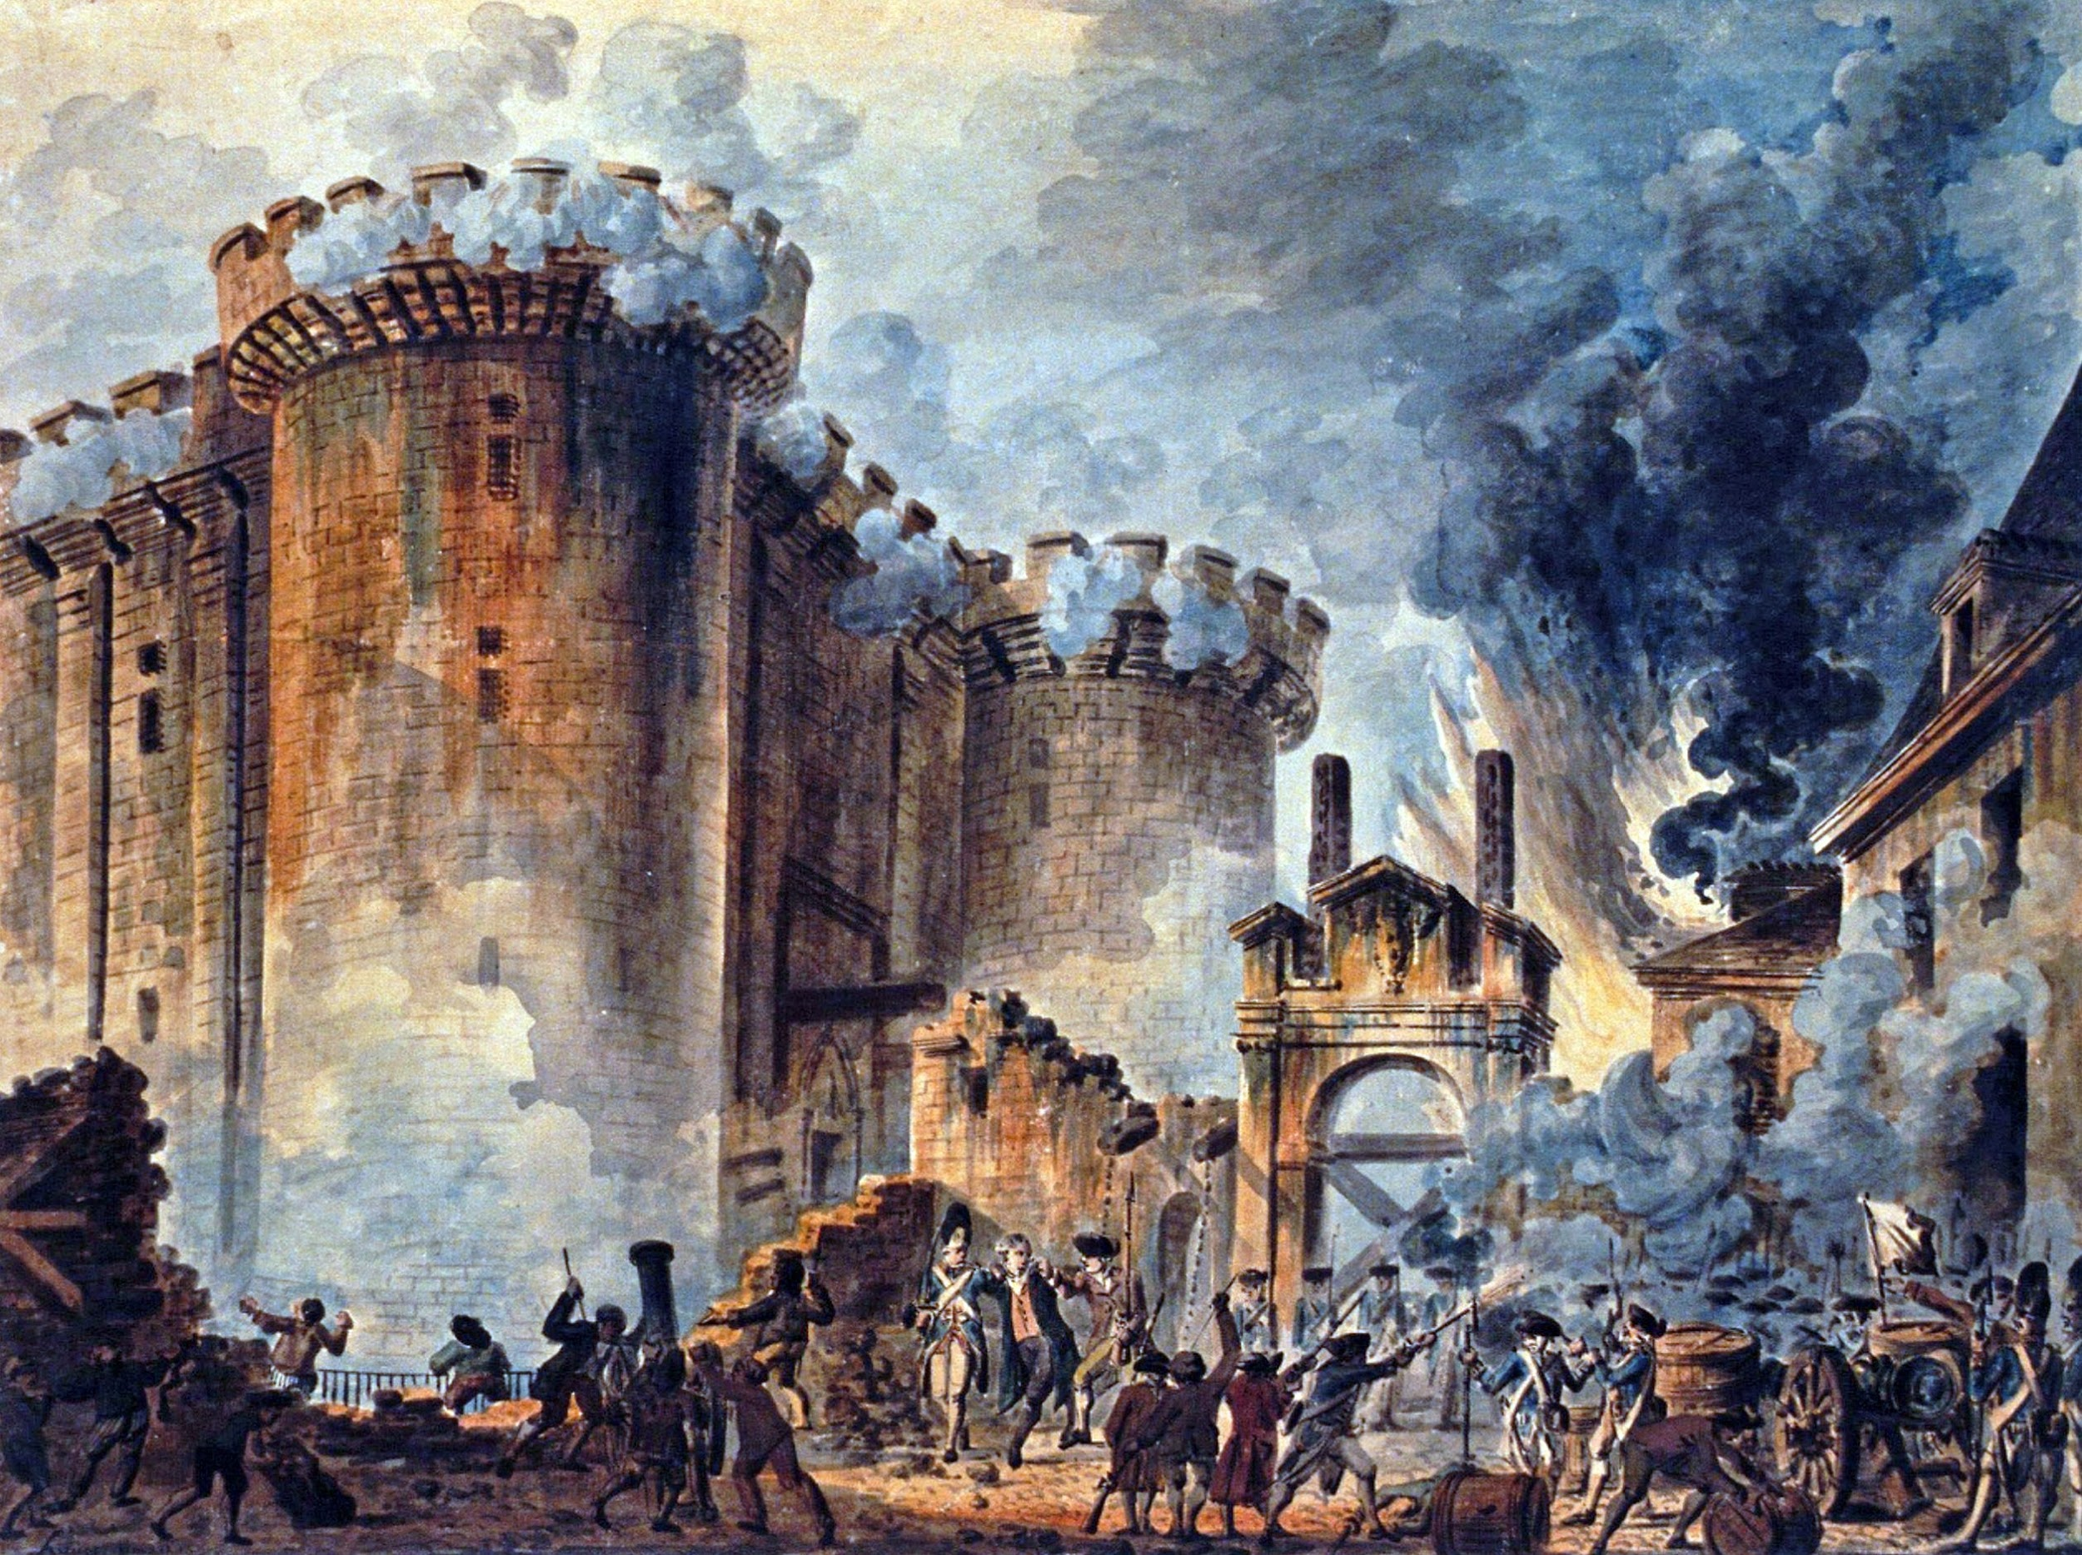
The Bastille
July 14,1789
Became known as France’s Independence Day
French citizens stormed the Bastille in search of weapons to fight the oncoming troops that King Louis XIV sent to Paris
The guards fought the citizens, but eventually the Bastille was taken

Slide 9
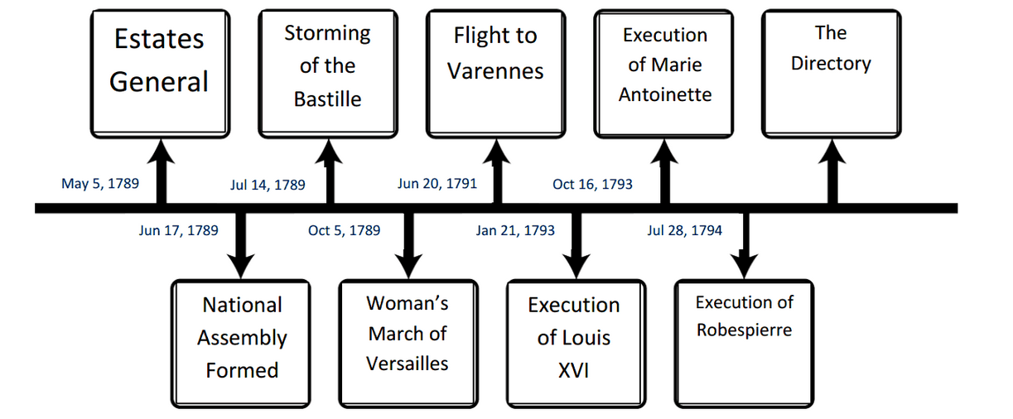
A new Revolt

Slide 10
Timeline for Change
National Assembly (1789-1791)
Turned France into a constitutional monarchy
Reign of Terror (1792-1794)
Death of the monarchy
Directory (1795-1799)
Reaction against extremeism
Age of Napoleon (1799-1815)
Revolutionary changes and dictatorship

Slide 11
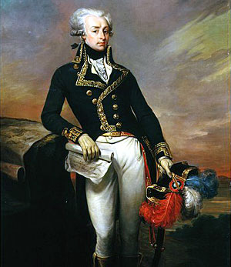
Revolt Begins
1789 – Political crisis and famine in France
The Great Fear
Rumors of attacks on villages and towns
Rumors of troops taking crops
Peasants revolted against nobles because of the rumors
Factions in Paris pushed for change
Middle class militias formed to oppose royal troops
Led by Marquis de Lafayette

Slide 12
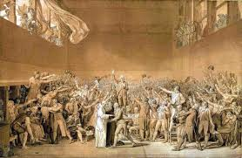
National Assembly
August 4th, 1789 – The National assembly (made of nobles) decided to end their tax privileges
Response to peasant uprisings
The Assembly created “The Declaration of Rights of Men and the Citizen”
Modeled after the American Declaration of Independance
“All men are born free and equal”
“liberty, property, security, and resistance to oppression”

Slide 13
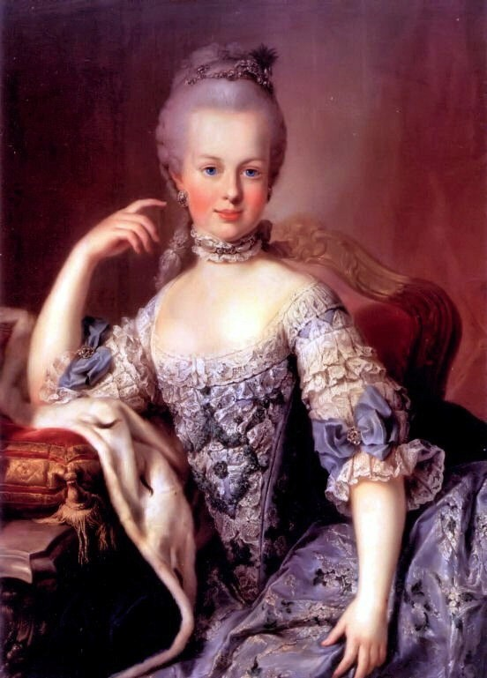
National Assembly
French women were not happy that the Declaration did not apply to them
Women’s March of Versailles – October 5th, 1789
13 mile march from Paris to Versailles in the rain
Demanded to see the king
The women were also angry with Marie Antoinette because she lived a wealthy life and the other women were suffering.
She did some acts for the poor, but her lifestyle was the main focus
They forced the King and his family to return to Paris where he was practically a prisoner

Slide 14
Radicals
1790 - French Catholic Church becomes controlled by the National Assembly
This angers the people because this allowed the clergy to become paid members of the government
The Constitution of 1791 makes a new government
Limited the powers of the monarchy
King Louis XIV tries to escape Paris, but fails
Rulers in other nearby countries feared that the revolution would spread
They did not want to be overthrown
Emigres spread stories of horror to nobles in nearby countries (Freedom fever)
Demands for a republic soon followed
French radicals in power soon declared war against other countries with monarchies (Austria, Prussia, Britain, and others.)

Slide 15
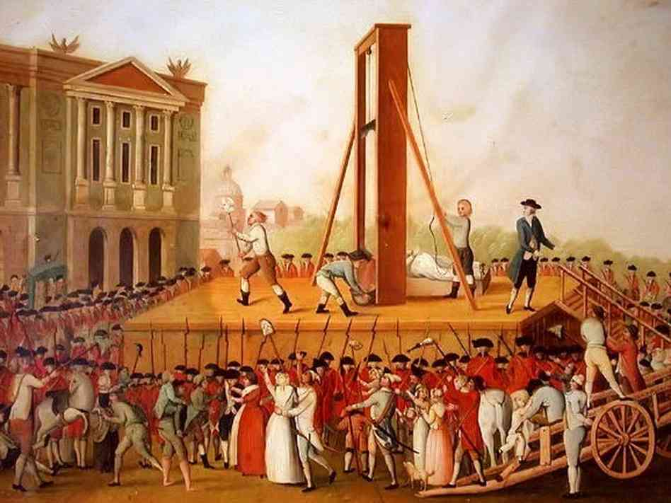
Terror

Slide 16
Terror
By 1792, mobs of citizens were storming palaces and other locations of nobility
Many people had been killed based on their status, or their affiliation with a person of higher status
More Radicals took over the Assembly
Lands belonging to nobles were siezed
Titles of nobility were abolished
All members of the royal family were executed by October 1792
By 1793, France’s revolutionaries had made enemies with most of Europe
War and hunger divided France, even after the nobles and monarchy were gone

Slide 17
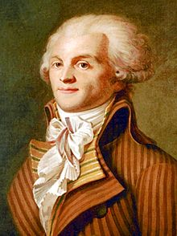
Terror
Committee of Public Safety was created to handle the war and hunger
The 12 members has nearly absolute power over France
Also in charge of trials and executions
Raised Taxes to support the war against European monarchies
Maximilien Robespierre
Lawyer and politician
Took leadership over the Committee
Said to be “incorruptible”
Advocate for mass executions

Slide 18
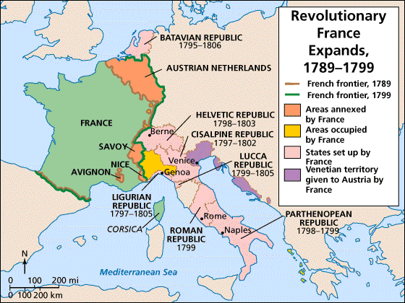
Nationalism

Slide 19
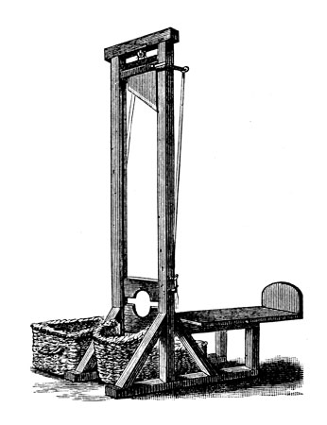
Reign of Terror
The radical part of the revolution slowed down after Robespierre and the Committee were executed in July of 1794.
This was known as the “Reign of Terror”
The guillotine was used as a tool to dispense “justice”
Around 400,000 people had been killed with the guillotine

Slide 20
The Directory
When the Reign of Terror ended, the Revolution entered its third phase
Moderates took over and created the Constitution of 1795
Created a five man directory and two-house legislature (mostly middle class)
Officials were now elected by the people
The new leadership also created peace with Prussia and Spain
Still at war with Austria and Britain
Emigres who fled France were returning
People who supported the monarchy began making their way into the Directory and legislature
Potential protests and riots began to form again

Slide 21
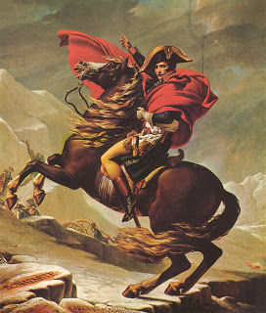
Napoleon
Napoleon Bonaparte
War hero
Victories against Italy and Austria
Politicians tried to use him for their cause
Napoleon outsmarted them and made himself the ruler of France

Slide 22
France’s new empire
Under Napoleon, France began to be empowered by Nationalism
Pride and devotion to your country
“Children of the Fatherland”
Slavery was abolished in all French colonies
“La Marseillaise” becomes France’s national anthem
https://www.youtube.com/watch?v=4K1q9Ntcr5g

Slide 23
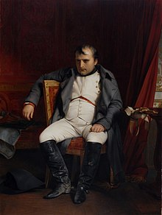
Age of Napoleon
Some loved him, some hated him
Ruled from 1799 to 1815
Crowned himself as Emperor of the French Empire
The crown was given by the Pope
Strong French support allowed him to get to where he was
Also known as a plebiscite (popular ballot vote)

Slide 24
Age of Napoleon
Napoleon reformed France under his rule
Strengthened central power
Focus was on order, security, and efficiency
Controlled the economy and built roads and canals
Made peace with the Catholic Church
He won support from all classes
Accepted the return of emigres if they took an oath of loyalty
Let peasants have rights to lands
Middle class liked the economic boom and order to the chaos
Opened jobs to all who were qualified

Slide 25
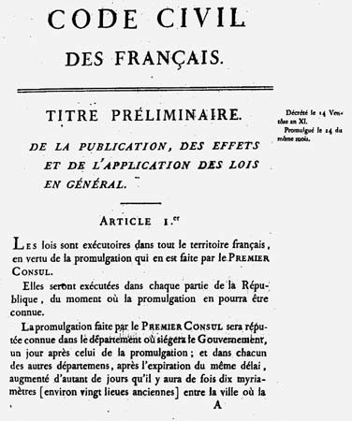
Age of Napoleon
Napoleonic Codes created
Equality to all citizens
Religious tolerance
Abolished feudalism
Women lost rights gained in the Revolution
Men had full authority in their households

Slide 26
French Empire
1804 to 1812
Napoleon defeated all opposition from other European countries
Britain was the final opponent
Annexed several areas to become a part of France
While Napoleon was fighting Britain, Britain was began fighting the U.S. in the War of 1812
He also sold a large chunk of land to the U.S., which became known as the Louisiana Purchase
This was to fund the war against Britain

Slide 27
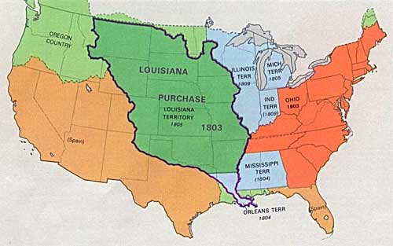
Louisiana purchase

Slide 28
The Collapse
Lands conquered by Napoleon began to revolt against the French
Revolts in Madrid, Rome, the Netherlands, and German regions
Spain and Austria fight France once more
Spain uses guerrilla warfare
The Tsar of Russia and Napoleon broke their alliance and went to war
Napoleon invades Russia
Russia retreats to Moscow
French troops starve and freeze during the harsh winter and retreat
Out of 600,000 troops, only 20,000 returned

Slide 29
The Collapse
Napoleon’s failure became well known
The new alliance of Britain, Russia, Prussia, and Austria defeated Napoleon at the Battle of the Nations Leipzig
Napoleon abdicated the following year in 1814
Exiled from France
King Louis XVIII became the new king of France
Not popular
Napoleon returns to power in 1815, but looses at the Battle of Waterloo against the British three months later
He’s exiled AGAIN
Napoleon died in 1821 while in exile

Slide 30
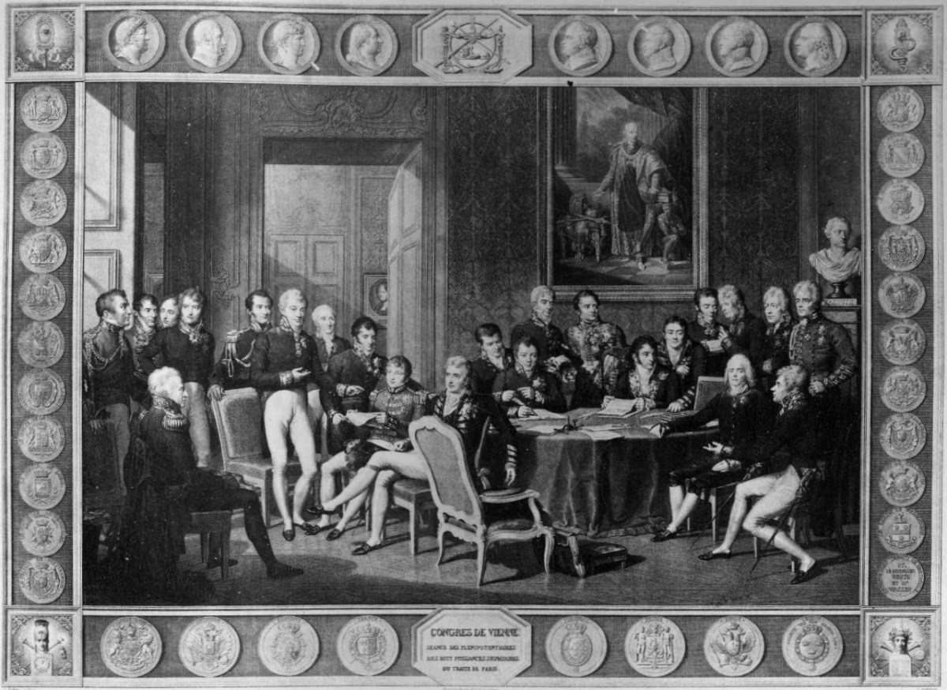
From the Ashes
Congress in Vienna restored order in France in 1815
Concert of Europe was a gathering of European leaders who pushed for peace in Europe
No wars on Napoleon’s scale for another 100 years

Slide 31
End

